Slide 1
Weather Ahead: Navigating the Future with Prediction
Vishnu Govindarajan
Register number: 2310092

Slide 2
Project introduction
Welcome to the introduction of our innovative predictive energy management system project!
As energy prices continue to rise, company is dedicated to providing cost-effective solutions for clients.
In response to the growing demand for renewable energy options, excited to propose a new service that leverages surplus renewable energy to benefit local customers.
This presentation will outline our plan to develop a reliable system for predicting energy surpluses at least 24 hours in advance, enabling to offer free energy to customers in eligible areas.
Our primary goal is to minimize false positives, ensuring efficient utilization of resources and maximizing cost savings for both our customers and the company.

Slide 3
Project Overview
Objective: Develop a system to predict surplus renewable energy at least 24 hours in advance.
Target Audience: Local customers in areas near renewable energy sources.
Pilot Duration: May 2024
Key Concern: Minimizing false positives to avoid unnecessary costs for the company.
Approach: Utilize historic energy records to analyse trends and patterns for accurate prediction.
Benefits: Cost-effective energy solution for customers, optimized resource utilization for the company.

Slide 4
methods
For preprocessing I had filled the null values using linear interpolation method
I had used four machine learning models Linear regression, Random forest, Gradient Boosting, XGBRegressor.
Then I had used two neural network model which is LSTM and CNN
In this linear regression got the high accuracy.
So I used linear regression for my prediction.

Slide 5
Methods
Wind Power Calculation:
Formula: P=0.5×A×ρ×V3×Cp
Assumption: Wind turbine capacity determined based on estimated average wind speed in the area.
Solar Power Calculation:
Formula: P=A×G×η
Assumption: Solar panel capacity determined based on assumed area coverage and average solar irradiance.
Surplus Energy Calculation:
Formula: Surplus = (Total Solar Power + Total Wind Power) - Energy Consumed by Colchester Residents
Total solar power and wind power aggregated from individual calculations.
Energy consumption data sourced from historic records for the Colchester area.

Slide 6
methods
Types of energy used: Solar and wind energy.
Location used: Colchester.
After finding the threshold I had implemented a decision making system it will tells us if there is surplus energy is there or not.

Slide 7
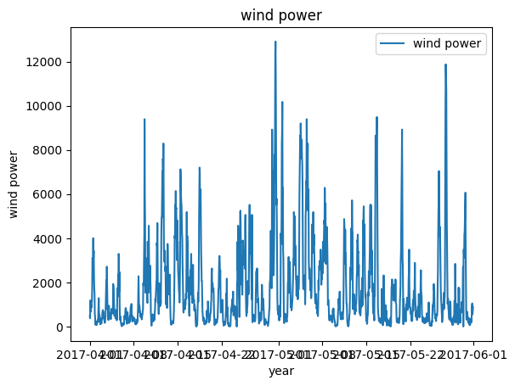
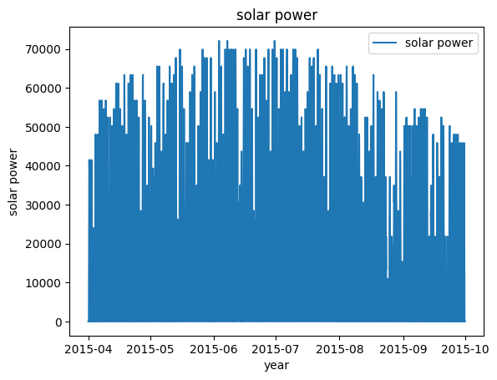
Graph for wind and solar power

Slide 8
Surplus results
I had found the surplus for he year 2019.
Total solar power for the year 2019: 55528200.0
Total wind power for the year 2019: 20464056.69
surplus energy is 74050176.69288401
By adding the total solar power and total wind power and subtract the total value from energy consumed then we can able to find the surplus energy.

Slide 9
Research and assumption
In a website I had found total number of wind turbines in the Essex state. 170 turbines are there in Essex. But there is no data for number of wind turbines in Colchester.
In Essex there are 14 districts so by dividing the number we can get 13 turbines in Colchester.
For solar panel I found on average 7280 homes have solar panel in Colchester. So I just assumed 7280 solar panel in Colchester.
This is how I made the assumptions.

Slide 10
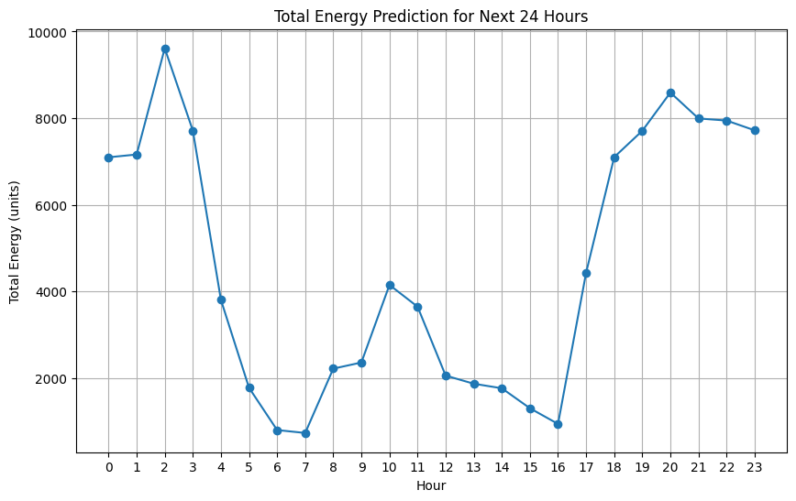
conclusion
After predicting the values for solar power and wind power after 24 hours from the give data. I had found that there is surplus energy in the Colchester.

Slide 11
Questions
1. Confident about your model. If your model fulfil the requirement of the company? Ans: Yes, I’m confident about my model. Because I had used more than 4 machine learning model and two neural network model, based on the best accuracy I had implemented the model for the prediction. So it will predict accurately and surplus will be calculated.
Is it ready to deploy at may 2024? Ans: Yes, model is ready to deploy at may 2024 if you have the data till may month it can predict the value for next 24 hours with high accuracy.
Limitations to be considered? Ans: Some of my assumptions are not 100 percent correct. Like the assumptions I did for number of solar panel in Colchester and number of wind turbine in Colchester.

Slide 12
reference
1.(Number of turbines in Essex) https://windsorstar.com/business/33698#:~:text=Combined%20with%20seven%20other%20wind,than%20350%20megawatts%20of%20electricity
2. (Number of solar panel in Colchester home) https://www.sunsave.energy/solar-panels-advice/uk-places/essex
3. (Electricity consumed by the Colchester people) https://www.colchester.gov.uk/sustainability/our-emissions/?id=&page=emissions--monitoring
4. (Wind power formula) https://www.e-education.psu.edu/emsc297/node/649
5. (Solar power formula) https://www.linkedin.com/pulse/how-calculate-output-solar-pv-system-detailed-guide-eman-rohayem#:~:text=For%20this%20step%2C%20the%20following,(kWh%2Fm2%2Fday)

